Slide 1


Financial Aid and Payment Information
2022 Certificate Entry Into Nursing Program
Presented by:
The Office of Student Financial Aid Services
The Office of the Bursar

Slide 2
Discussion Items
Office of Student Financial Aid Services
  Financial Aid Timeline
  Complete the FAFSA/Dependency Status
  Federal and Private Loan Options
  Spring 2022 Cost of Attendance
  Fixed Enrollment Date – Day 10
  Contact Information

Slide 3
Financial Aid Timeline
Mid November
Receive and review spring aid, apply for a private alternative loan or PLUS loan for spring, if needed
Late May
Receive and review fall aid, apply for a private alternative loan or PLUS loan for fall, if needed
September
Complete the 21/22 Free Application for Federal Student Aid (FAFSA)
October
Complete the 22/23 Free Application for Federal Student Aid (FAFSA)
March/April
Receive and review summer aid, apply for private alternative loan or PLUS loan for summer, if needed
Notes:
Emphasize 2 FAFSA’s need to be completed, and apply for loans three separate terms

Slide 4
Complete the FAFSA
Studentaid.gov-UConn’s school code is 001417.
Answer the following questions on the FAFSA:
Degree/Certificate: Select Second Bachelor’s Degree
Current Grade Level: Select 5th year Undergraduate
Answer “No” to the question: “Are you a graduate student?”

Slide 5

Determining Dependency Status
Step Three of the FAFSA application will determine if you will be required to provide parental information.
Example of some of the questions asked
on the 21/22 FAFSA:
Were you born before January 1, 1998?
Are you married?
Are you a Veteran of the U.S Armed Forces?
Do you have children?
Are you a graduate student? (answer is no)

Slide 6
CEIN Student Aid Types
School of Nursing
Merit
Scholarships
Loan Options:
Federal
Private

Slide 7
Undergraduate Loans at a Glance
Program | Borrower | Credit Check Required? | Interest Rate As of 7/1/21* | Repayment Begins
Federal Direct Subsidized Loan | Students with financial need | No | 3.73% | Six months after graduation
Federal Direct Unsubsidized Loan | Students | No | 3.73% | Six months after graduation
Federal Direct PLUS Loans | Parents | Yes | 6.28% | Sixty days after second disbursement unless deferred
Private/Alternative Loans | Students with a creditworthy cosigner | Yes | Variable or fixed; usually depends on borrower and cosigner credit scores | Varies by loan product
* Interest rates subject to change effective July 1, 2022

Slide 8
Federal Student Loans Per Semester
Student Status | Federal Direct Subsidized Loan Limit | Federal Direct Unsubsidized Loan Limit
Dependent Undergraduate | $2,750* | $1,000
Independent Undergraduate | $2,750* | $3,500
*Students must have financial need to be eligible for a
Federal Direct Subsidized Loan.

Slide 9
Undergraduate Aggregate
Federal Direct Loan Limits
Student Status | Federal Direct Subsidized Loan Limit | Total Loan Limit
Dependent Undergraduate | $23,000 | $31,000
Independent Undergraduate | $23,000 | $57,500

Slide 10
Applying for Federal Direct Student Loans
Students must complete the following requirements if they would like to borrow Federal Direct Student Loans after a FAFSA is filed.
Complete Entrance Counseling
studentloans.gov
Accept loan offer
Student Administration System
Complete a Master Promissory Note
studentloans.gov
Notes:
Federal regulations require first-time student loan borrowers to complete Entrance Counseling and complete a Master Promissory Note (MPN).
Entrance counseling informs students of their rights and responsibilities
MPN – students provide information and promise to repay the loan(s)
Complete process at www.studentloans.gov
Allow 2-3 business days for our office to receive the electronic notification

Slide 11

Federal Direct Parent (PLUS) Loans for Dependent Undergraduate Students
Applying for Federal Direct PLUS Loans
Three Applications - Spring, Summer, Fall
Parent completes an online application and, if approved, a Master Promissory Note via StudentAid.gov
Parents will need to apply every semester: spring, summer, and fall
Credit check will be performed by the US Department of Education
Student accepts PLUS eligibility through Student Administration System
Notes:
Dependent CEIN students—Parent can apply for PLUS
Go over app process
Parent will need to apply 3 separate times, three loan periods spring, summer, fall

Slide 12
Applying for a Private (Alternative) Loan
UConn's Suggested Private (Alternative) Loan Lender list via ELMSelect: financialaid.uconn.edu/altloan/
  Variable or fixed interest rates; many have no cap
  Repayment options vary by lender
Must apply directly with your chosen lender
Apply once per semester: spring, summer, fall
  Spring Loan Period: January to May 2022
  Summer Loan Period: May to August 2022
  Fall Loan Period: August to December 2022

Slide 13
Spring 2022 CEIN Cost of Attendance
COA Budget Item | Storrs On/Off Campus | Regional On/Off Campus
Program Fee | $13,005 | $13,005
Additional Fees | $393 | $329
Room and Board Estimate | $7,470 | $7,470
Misc. Expenses Estimate | $1,094 | $1,094
Books | $1,000 | $1,000
Transportation | $1,867 | $1,867
Total Direct Costs | $13,398 | $13,334
Total Direct / Indirect Costs | $24,829 | $24,765

Slide 14
Fixed Enrollment Date-Day 10
Financial Aid offers are based on the assumption that you will enroll as a full-time student on or before the tenth day of classes, each semester.
If you are not enrolled full-time (12 or more credits) by Day 10, your aid could be reduced or cancelled.
Spring Semester Day 10: January 31, 2022

Slide 15
Office of Student Financial Aid Services
Open Monday – Friday
  8:00AM – 5:00PM EST
Ways to contact our office:
  Email financialaid@uconn.edu
  Telephone (860) 486-2819
  In-Person, Storrs Campus
Visit our website for additional information:
  financialaid.uconn.edu

Slide 16

Office of the Bursar
Facilitates billing of tuition and fees
Tuition and fee collection
Issues refunds
  Financial Aid
  Overpayment

Slide 17
Discussion Items
Office of the Bursar
  University Fee Bills
  How to View Your Fee Bill
  CEIN Cost
  Payment Options
  Late Payments
  Refunds
  Direct Deposit
  Contact Us

Slide 18
University Fee Bills
Spring
Bills posted online and email notifications sent out in late November
Due Date: January 8
Refunds: End of January
4 month payment plan available
Summer
Bills posted online in April
Due Date: Varies
Refunds: End of May
No payment plan available
Fall
Bills posted online late June
Due Date: August 1
Refunds: End of August
4 month payment plan available

Slide 19
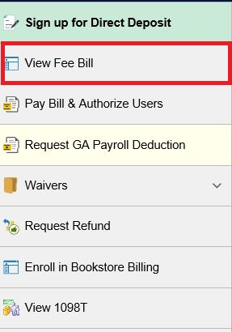
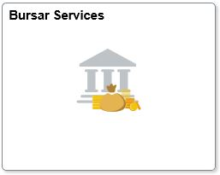

Where can I view my Fee Bill?
Fee bills are issued in the Student Administration System (system of record)
Action Items for Fee Bills
SF Agreement
  “Announcements” Tile
Health Insurance waiver
  2/5
  9/15
Title IV waiver
  MISC Fees

Slide 20
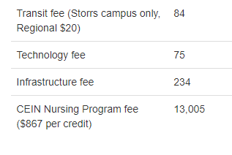
How much does CEIN cost?
An example of costs per term as a CEIN student are below:
Calendar Year 2021-2022
Transit Fee
  Storrs Campus only
Technology fee
Infrastructure Fee
Tuition
  ($867.00 per credit)

Slide 21
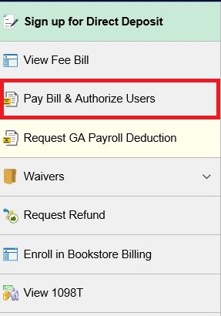
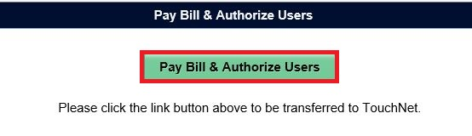
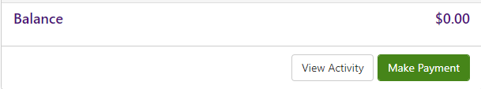

Payment Options
Electronic
E-check
Credit Card (2.85% Convenience fee)
Western Union
In person/mail
Check, bank check, money order, 529
No Cash Accepted
Payment Plan
$100.00 enrollment fee, per term
4 equal installments
Fall 7/15, 8/15, 9/15, 10/15
Spring 12/15, 1/15, 2/15, 3/15

Slide 22
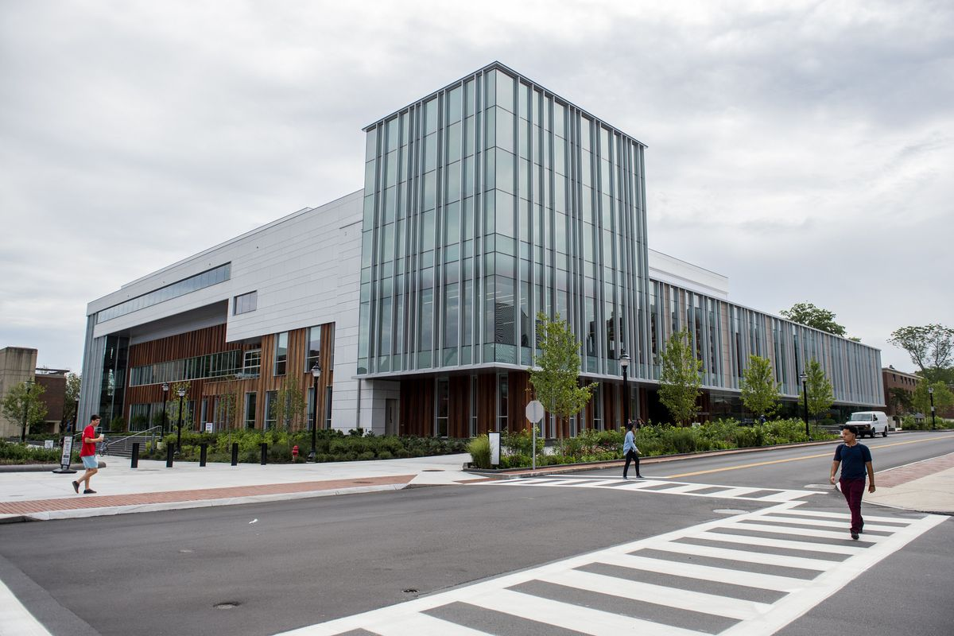
If I miss the due date...
Can I still attend my classes and move into my dorm?
Yes. We do not drop courses for non-payment and you can still move into your dorm
Will I be charged late fees?
Yes, up to $300 for late payments
$50 per each missed/late payment plan installment
Will late payments impact my access to University services?
Yes, a hold on your account will prevent you from making changes to your registration, you may not access the Rec Center or your official transcripts until your account is paid in full

Slide 23
Refunds are issued when:
Fee bill is paid in full
Enrollment matches financial aid package
Financial aid is processed and disbursed
Direct deposit for students
Federal Parent Plus Loan refunds are written directly to parent and mailed home

Slide 24
Direct Deposit for Students
Sign up for Direct Deposit now by logging into the Student Administration System:
studentadmin.uconn.edu
Student Center Homepage > Bursar Services > Sign up for Direct Deposit

Slide 25
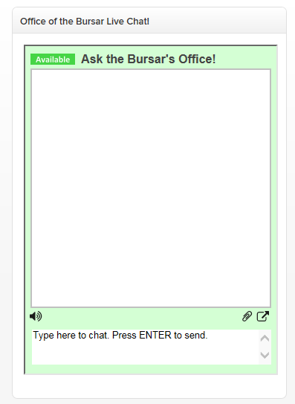
Office of the Bursar
The Office of the Bursar is open 12 months a year; Monday through Friday,
8am - 5pm.
Contact:
Email - (bursar@uconn.edu)
Telephone – (860) 486-4830
Live Chat - bursar.ucconn.edu
Payment Drop Box

Slide 26
Thank you!
We hope you enjoy your semester.
Contact us with any questions!

