Slide 1
Financial Aid and Payment Information
2023 Certificate Entry Into Nursing Program
Presented by:
The Office of Student Financial Aid Services
The Office of the Bursar

Slide 2
Discussion Items
Office of Student Financial Aid Services
Complete the FAFSA
Determining Dependency Status
Federal and Private Loan Options
Fixed Enrollment Date – Day 10
Contact Information

Slide 3
Complete the FAFSA Free Application for Federal Student Aid (FAFSA)
Complete two FAFSA's:
2022-2023 FAFSA (spring and summer semester aid)
2023-2024 FAFSA (fall semester aid)
studentaid.gov
Financial Aid Offers will be available:
Spring Semester: Mid-November
Summer Semester: April
Fall Semester: Late-May

Slide 4
Complete the FAFSA
Studentaid.gov - UConn’s school code is 001417.
Answer the following questions on the FAFSA:
Degree/Certificate: Select Second Bachelor’s Degree
Current Grade Level: Select 5th year Undergraduate
Answer “No” to the question: “Are you a graduate student?”

Slide 5
Determining Dependency Status
Step Three of the FAFSA will determine if you will be required to provide parental information.
Example of some of the questions asked
on the 22/23 FAFSA:
Were you born before January 1, 1999?
Are you married?
Are you a Veteran of the U.S Armed Forces?
Do you have children?
Are you a graduate student? (answer is no)

Slide 6
CEIN Program - Forms of Aid
School of Nursing - Merit Scholarships
Federal Loans
Private Alternative Loans

Slide 7
Undergraduate Loans at a Glance
Program | Borrower | Credit Check Required? | Interest Rate As of 7/1/22* | Repayment Begins
Federal Direct Subsidized Loan | Students with financial need | No | 4.99% | Six months after graduation
Federal Direct Unsubsidized Loan | Students | No | 4.99% | Six months after graduation
Federal Direct Parent PLUS Loans | Parents | Yes | 7.54% | Sixty days after second disbursement unless deferred
Private/Alternative Loans | Students (Some may need a creditworthy cosigner.) | Yes | Variable or fixed; usually depends on borrower and cosigner credit scores | Varies by loan product
* Interest rates subject to change effective July 1, 2023

Slide 8
Federal Student Loans Per Semester
Student Status | Federal Direct Subsidized Loan Limit | Federal Direct Unsubsidized Loan Limit | Total Loan Offer Each Semester
Dependent Undergraduate | $2,750* | $1,000 | $3,750
Independent Undergraduate | $2,750* | $3,500 | $6,250
*Students must have financial need to be eligible for a
Federal Direct Subsidized Loan.

Slide 9
Undergraduate Aggregate Federal Direct Loan Limits
Student Status | Federal Direct Subsidized Loan Limit | Total Loan Limit
Dependent Undergraduate | $23,000 | $31,000
Independent Undergraduate | $23,000 | $57,500

Slide 10
Applying for Federal Direct Student Loans
Students must complete the following requirements if they would like to borrow Federal Direct Student Loans after a FAFSA is filed.
Complete Entrance Counseling
studentaid.gov
Accept Loan Offer
Student Administration System
Complete a Master Promissory Note
studentaid.gov
Notes:
Federal regulations require first-time student loan borrowers to complete Entrance Counseling and complete a Master Promissory Note (MPN).
Entrance counseling informs students of their rights and responsibilities
MPN – students provide information and promise to repay the loan(s)
Complete process at www.studentloans.gov
Allow 2-3 business days for our office to receive the electronic notification

Slide 11
Federal Direct Parent (PLUS) Loans for Dependent Undergraduate Students
Parents can Apply for a Federal Direct PLUS Loan
Three Applications - Spring, Summer, Fall
Parent completes an online application and, if approved, a Master Promissory Note via StudentAid.gov
Parents will need to apply every semester: spring, summer, and fall
Credit check will be performed by the US Department of Education
Notes:
Dependent CEIN students—Parent can apply for PLUS
Go over app process
Parent will need to apply 3 separate times, three loan periods spring, summer, fall

Slide 12
Applying for a Private (Alternative) Loan
UConn's Suggested Private (Alternative) Loan Lender list via ELMSelect: financialaid.uconn.edu/altloan/
Variable or fixed interest rates; many have no cap
Repayment options vary by lender
Must apply directly with your chosen lender
Apply once per semester: spring, summer, fall
Spring Loan Period: January to May 2023
Summer Loan Period: May to August 2023
Fall Loan Period: August to December 2023

Slide 13
Fixed Enrollment Date-Day 10
Financial Aid offers assume that you will enroll as a full-time student on or before the tenth day of classes, each semester.
If you are not enrolled full-time (12 or more credits) by Day 10, your financial aid could be reduced or cancelled.
Spring Semester Day 10: January 30, 2023

Slide 14
Office of Student Financial Aid Services
Open Monday – Friday
8:00AM – 5:00PM EST
Ways to contact our office:
Email financialaid@uconn.edu
Telephone (860) 486-2819
In-Person, Storrs Campus
Visit our website for additional information:
financialaid.uconn.edu

Slide 15
Money Matters
Notes:
Welcome to the Money Matters presentation presented by the Office of the Bursar and the Office of Student Financial Aid Services.

Slide 16
Office of the Bursar
Bills for tuition and fees
Receives payment
Issues refunds for overpayments on a student’s account
Notes:
Here at UCONN, the Office of the Bursar….
bills for tuition and fees. Receives payment for tuition, fees and Issues refunds for overpayments on a student’s account.
Students might have overpayments refunded to them to pay for living expenses and or school supplies.

Slide 17
Fee Bill
Fun fact to help remember!
1881 is the year UConn was founded.
Spring bills are due January 8th (1/8)
Posted late-November (after Thanksgiving)
Fall bills are due August 1st (8/1)
Posted mid-June
Notifications may include…
When fee bills are issued
Additional charges are added
Due dates
Changes in account
How will I be billed at UConn?
Fee Bills are issued electronically ONLY
All notifications are sent to the student UConn.edu email address
Notes:
Fee bills at UConn are only issued electronically. We do not issue paper bills and we do not mail paper bills.
A quick and easy way to remember the due dates for the fee bills is “1881”. 1881 is the year UConn was founded. Spring bills are due on the 1st in January, and fall bills are due on the 8th in August.
Fall fee bills are posted in mid-June and Spring fee bills are posted in mid-November, titled “New Charge Notification”.
All Office of the Bursar notifications are sent to the students UConn.edu email address.
Notifications may include when fee bills are issued, additional charges are added to your account, charges removed from your account, reminders about due dates, and other useful information. Be sure to check your UConn.edu email address frequently for these notifications.
Please note that if you, the parent, or another party pays the fee bill, you will not be notified of new charges unless the student tells you. You will not be sent notifications from our offices, as the notifications go directly to the students UConn.edu email address.
Tuition and fee rates are available at bursar.uconn.edu, where you can select “Students/Parents” and then click on your program. Please note that there may be other charges on your account that aren’t tuition and fees, for example room and board.

Slide 18
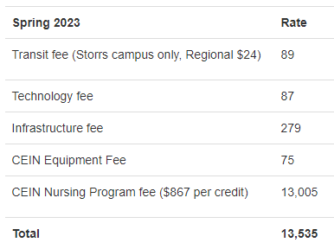
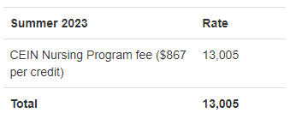
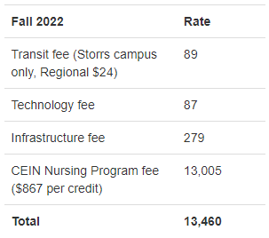
How much does CEIN cost?
Website: bursar.uconn.edu, click Tuition & Fees, Grad Student, CEIN Program Fees
Mandatory Fees
Transit Fee ($89 Storrs, $24 Regional)
Technology fee
Infrastructure Fee
Tuition
Waivable Fee
$2946 Student Health Insurance
$285 Husky Book Bundle Fee
Notes:
For the CEIN Program Fees, please visit bursar.uconn.edu, click “Tuition & Fees”, “Graduate Students”, scroll down to the bottom and click “CEIN Program Fees.”
The CEIN Program Fees will give you a tuition and fee break down. The per/credit rate will hold at $867 for the 2023 cohort
Mandatory Fees for Fall and Spring include the following….
1. )Transit Fee- ($89 Storrs and $24 for Regional Campuses)- Storrs- the Fee supports the campus shuttle bus service, Safe Rides late at night and the Accessible Van Service (AVS). Regional Students (Hartford, Stamford, Waterbury)- Fee allows students access to the Connecticut Department of Transportation’s U-Pass program. U-Pass CT is valid for unlimited rides within Connecticut on all local & express buses, CTfastrak, Shore Line East (rail), and intrastate New Haven (rail) services. The Transit Fee includes the cost of operations, vehicle purchase and maintenance, and administrative support. Fee also pays the cost of the UConn WRTD bus pass program.
2.) Technology Fee- Fee supports IT services that include hi-tech classrooms, software licensing and delivery, computers in common-use areas, and wireless.
3.) Infrastructure Fee- Fee supports debt service associated with residence halls and partially supports Operating and Maintenance costs related to UConn 2000 construction projects as well as preventive and deferred maintenance.
The CEIN is not a traditional UNDERGRAD program. The program is a post-bachelor certificate, therefore we do not charge all the mandatory fees, such as a traditional UNDERGRAD student would see on their fee bill.
Waivable fees..
Full-time students are required to carry health insurance. If they are covered under another plan, they can waive the $2946 cost.
If they do not waive the plan by September 15th each year, they will be responsible for the cost for that academic year.
This waiver only lasts one year. They must waive it each year if they do not wish to enroll in the health insurance plan.
The CEIN population will be billed the $285 Barnes and Noble Fee due to being in the UNDERGRAD career. This is new for this upcoming Spring and CEIN students may have to opt out of that charge.

Slide 19
Husky Book Bundle Fee
Reduce the cost of traditional textbooks by up to 50% with Husky Book Bundle!
Partnership with Barnes & Noble
Available to full-time undergrad students
Students are prepared for the first day of class
$285 Rental Fee (Course materials at a reduced price)
Charged to fee bill
Opt-Out Period (30 days prior to 1st day of class & ends on the 10th day of class)
Student returns course materials at the end of the session
Info: https://bookbundle.program.uconn.edu/
Opt-Out: https://sso.bncollege.com/bes-sp/bessso/saml/uconnedu/fdcopt/logon
Notes:
Husky Book Bundle Program is through a partnership with Barnes & Noble.
… the program will help reduce the cost of traditional textbooks up to 50%!!
The Husky Book Bundle is a textbook savings program that delivers student course materials at a reduced price.
The program will provide an affordable option and supports student success by ensuring every participating student is prepared for the first day of class.
The program is only available to full-time undergraduate students. The $285 Husky Book Bundle RENTAL fee will be charged directly to the student's fee bill.
The student can opt-out of the program. IF the student wishes not to enroll in the Husky Book Bundle Program, they will have the option to opt-out of this program. The opt-out period for each semester is open 30 days prior to the first day of class and ends on the 10th day of class. Once opted out, you will not receive access to your materials and will be responsible for purchasing all required course materials from the UConn Bookstore. If the students wishes not to be charged full price for the course materials, they must return all course materials at the end of the session the the bookstore.
Please visit the links mentioned shown in the slide for more information on the program and to opt out of the Husky Book Bundle Program.
Info: https://bookbundle.program.uconn.edu/
Opt-Out: https://sso.bncollege.com/bes-sp/bessso/saml/uconnedu/fdcopt/logon

Slide 20
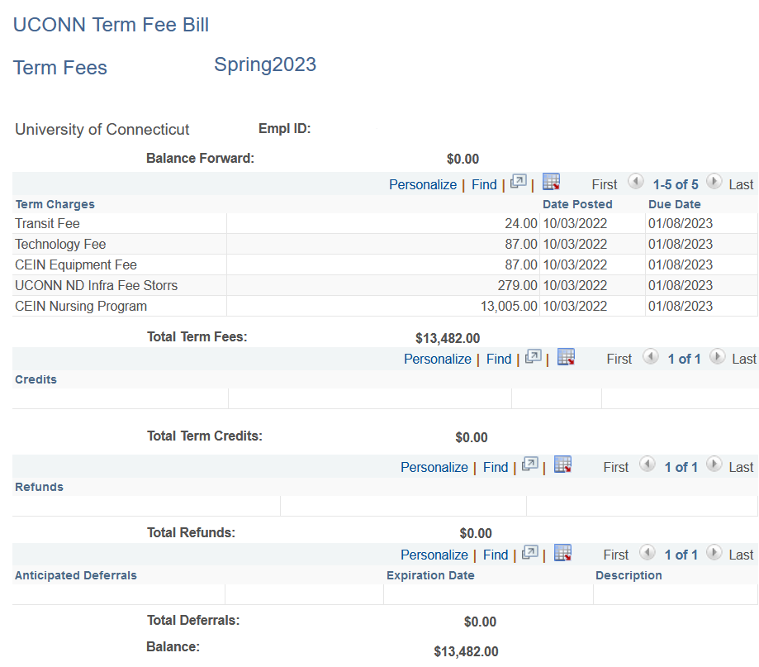
Viewing Fee Bill in Student Admin
Charges
Due date
Credits
Refunds
Deferrals
Balance due
Notes:
The student can view their fee bill in student admin as well as Flywire the payment software. Once the student pulls up their fee bill, it is important to understand what each section means.
The top section states charges, or in other words, tuition, fees, and any other expenses they will have to pay for. There will be a due date for each charge.
The next section is the credits section. This section represents any payments they have made out-of-pocket, loans, scholarships, waivers, or anything else that will pay their bill.
Refunds are given if the bill is overpaid. If a parent has taken out a parent loan, the amount will be refunded to them.
Anticipated Deferrals are payments that are expected to come in and post on their account.
Deferrals are most commonly placed when UConn is expecting a loan or scholarship to pay for their bill. Please note that if the funds do not come in, they will be responsible for the balance that remains.
The balance at the bottom of the screen is the amount they owe. If the balance is negative, it means the account has been overpaid. In this case, they may receive a refund.

Slide 21
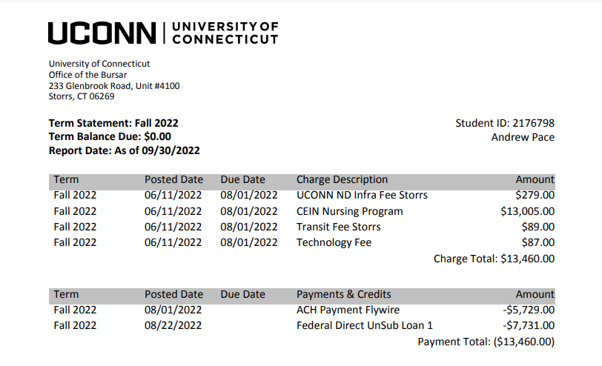
Viewing Fee Bill in Flywire
Due date
Charges
Credits
Notes:
The student can also view their fee bill in Flywire our payment software.
The bill does look different compared to the student admin version. The Flywire fee bill will still show the charges, due date, payments and deferrals that are on the account. In Flywire, you will be able to select the session, download and print with the UCONN logo and address on the fee bill.

Slide 22
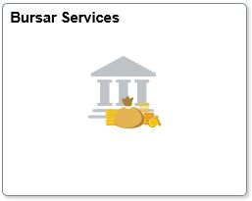
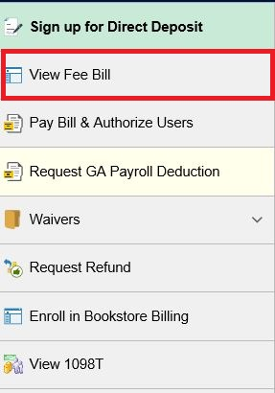
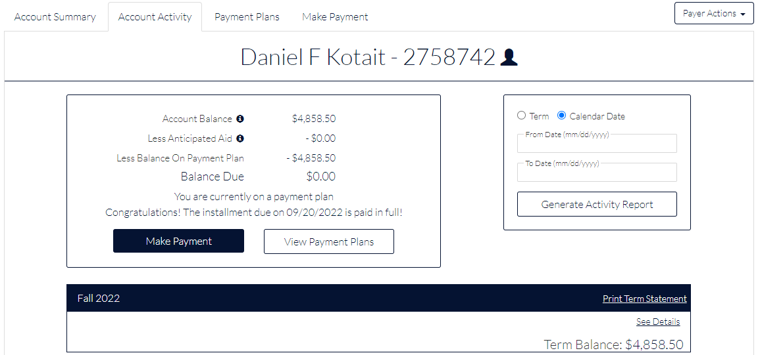
View & Download your Fee Bill
Log in to studentadmin.uconn.edu
Click "Bursar Services" tile
“View Fee Bill” OR “Pay Bill & AU”
Make a payment & enroll in a payment plan
Download & print fee bill w/ UCONN logo & address
Notes:
So, once the student gets a new charge notification, what should the student do?
Log into their Student Admin account online at studentadmin.uconn.edu. Student Admin is the only place they will be able to access their fee bill.
Click Bursar Services and then click View Fee Bill. The student will be able to click “Account Activity”, select current or past semester, download and print a fee bill. All fee bills will have the UConn logo and address.

Slide 23
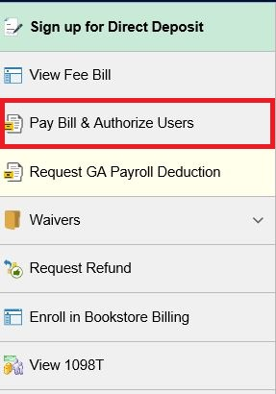
Payment Options
3 Types of Electronic Payments
E-check
Credit Card (2.75% Convenience fee)
Western Union- Wire transfer/international students
You can mail and or place a check in a drop box
Check, money order, 529 check
MUST include UNIT 4100 in address & name along with student ID
Wilbur Cross Building (Storrs) & regional campuses
University of Connecticut
233 Glenbrook Rd, Unit 4100
Storrs, CT 06269-4100
6 New Payment Plans
Open to students with a balance over $300
Available once fee bills are posted
Notes:
There are multiple ways to pay the fee bill.
Electronic payment options are the fastest and most secure methods of payment. To make a payment online, log into StudentAdmin, click on Bursar Services and then Pay Bill & Authorize Users to be directed to our payment website.
E-checks, or electronic checks, uses your banking information to process a secure payment online. There is no fee to pay via e-check.
Credit cards can be used online as well. To use a credit card, you will be charged a 2.75% convenience fee.
For international students, they can pay their bill via wire transfer through Western Union.
The student can still mail a check, bank check, money order, or a 529 payment, but know that there may be delays in processing depending on the mail system.
You can also use our drop box at the Storrs campus or any regional campus, which accepts checks, bank checks, money orders, and 529 payments.
Please do not mail or place cash in the drop box!!
If you can’t pay your bill at once, we offer payment plans! We have 6 new payment plans for the Fall and spring sessions. Payment plans are open to anyone who owes a balance over $300. We do not offer payment plans during the summer and winter sessions.
For more information on our payment plans, please visit our website!

Slide 24
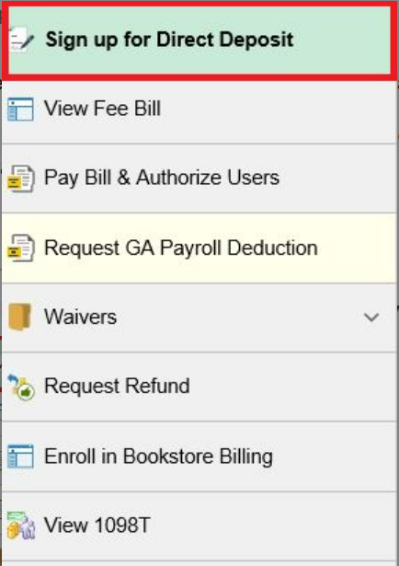
Direct Deposit
Refund checks for the beginning of a semester will be issued within 14 days of Financial Aid disbursement.
Direct deposit
Set DD up in student admin
2-3 business days to arrive in bank account
Paper check Refund will be….
Refund checks are issued remotely by Bank of America and emailed to the mailing address on file
Mailed to mailing address on student file
Only cut on Wednesdays (once per week)
Takes 1-2 weeks to receive depending on mail system
No international checks issued ( delivered direct deposit or international wire)
Notes:
Most UConn students receive some form of refund during their studies.
Refund checks for the beginning of a semester will be issued within 14 days of Financial Aid disbursement.
Checks are not available for in-person pickup. Refund checks are cut on Wednesday and mailed to the address on file.
Due to these reasons, we recommend all students to enroll in direct deposit.

Slide 25
FERPA
Ferpa.uconn.edu
The FERPA pin refers to a federal law requiring students to create a pin for any individual wishing to speak on behalf of the students account besides themselves.
Notes:
Per FERPA, the Family Educational Rights and Privacy Act of 1974, the student owns their educational records. However, there are certain circumstances in which the student can allow others access to their records.
The FERPA code refers to a federal law requiring students to create a pin code for any individual wishing to speak on behalf of their account besides themselves.

Slide 26
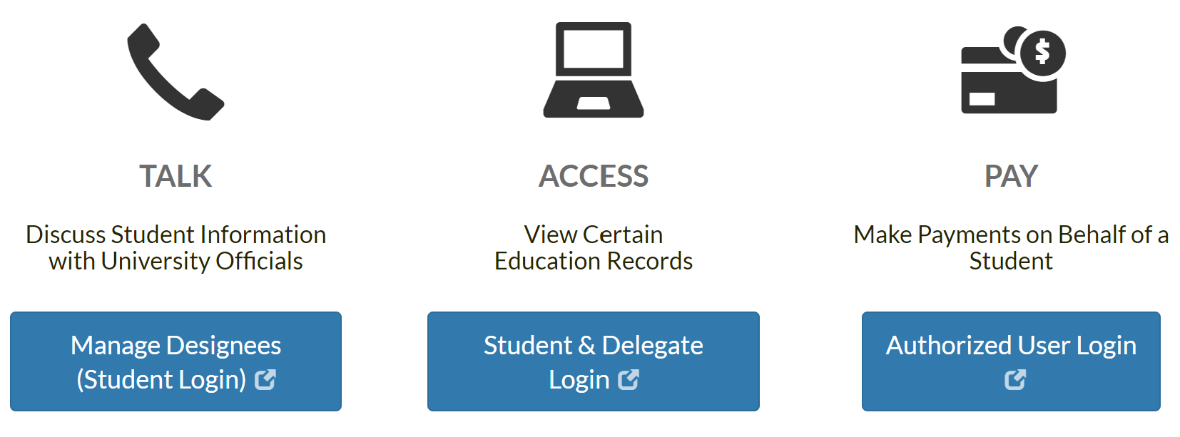
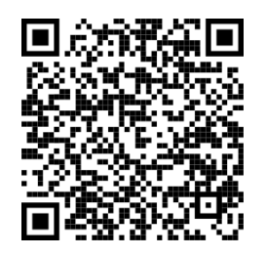
3 Types of Access- FERPA
Notes:
The student can set up 3 types of access for a parent or guardian by…
By visiting ferpa.uconn.edu or scanning the QR code
Select the "share my information" tab at the top of the webpage.
Select the type of access you wish to grant
Login with NetID and password
“Add designee“
To allow us to legally talk and email with someone else about the student's bill, the student must set up a FERPA PIN for them:
When creating a pin, make sure to check off “Student financial information” as a permission, save and submit.
Once they create a 4-digit FERPA PIN, this allows access to talk about Student Financial Information.
We can only talk with a parent or payer if they provide us that FERPA PIN. Otherwise, we cannot talk about the student's account.
To allow someone else to access your account, you must set up “Delegate Access”.
This type of access can be set up in the Student Admin Account
They can only view your records.
To allow someone else to pay their bill online, they must set them up as an Authorized User.
Authorized Users need a 4-digit FERPA pin, can view billing and make payments.

Slide 27
Contact Information
Client Service Center
Hours: 8am-5pm, M-F
860-486-4830
bursar@uconn.edu
Live Chat at bursar.uconn.edu
uconnbursar
Notes:
The Office of the Bursar Client Service Center business hours are Monday-Friday, 8am-5pm. You can reach our center by calling 860-486-4830, by email at bursar@uconn.edu or Live Chat at bursar.uconn.edu.
Thank you and have a great day.

